Slide 1
Module 4. Page Management

Slide 2
MODULE 4. Page Management
What you will learn from this module:
  updating and editing page properties
  how to add/delete user groups from the roles granting set-up
  how to create/delete pages
Notes:
©2005 Microsoft Corporation. All rights reserved.
This presentation is for informational purposes only. Microsoft makes no warranties, express or implied, in this summary.

Slide 3
Module 4. Page Management
Notes:
Pages are organized hierarchically.
The home page (/default.shtml) is the top level page.
Any other page has a parent page. e.g.
Home
  About this site
  National Contacts
    National Focal Points
    Competent National Authorities
    National Websites and Databases
  Laws and Regulations
    National Laws, Regulations & Guidelines
    …

Slide 4
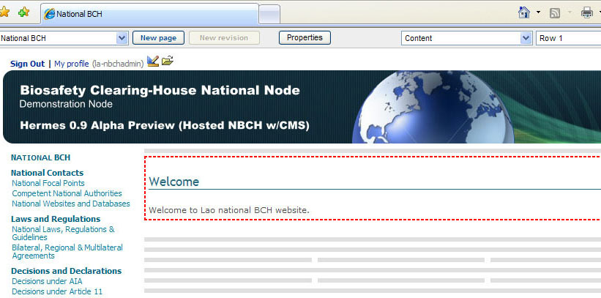

4.1 Page Properties
Click on the "Properties" button to access the Page properties.
CLICK HERE

Slide 5
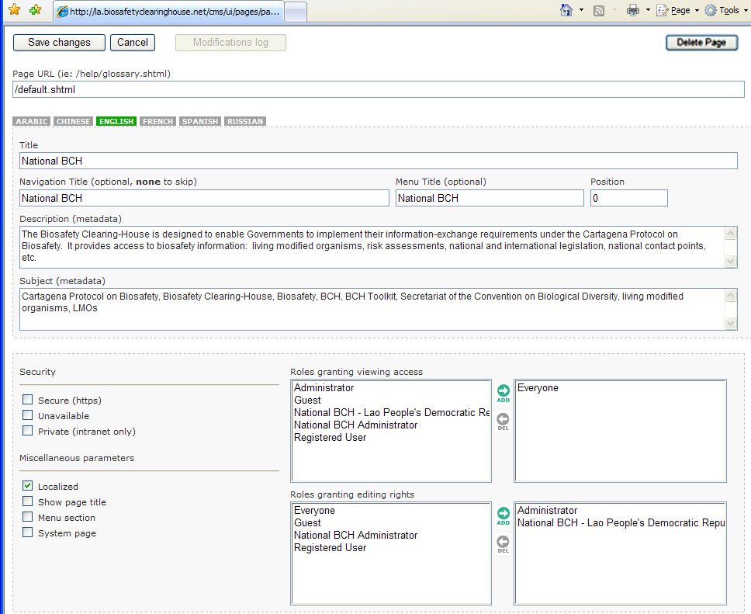

4.1 Page Properties
Descriptions for
each item of the
Property Page
all pages MUST have the .shtml extension
the home page (/default.shtml) should not be renamed
Renamed pages keep their content
Changes to page name are automatically reflected in the menu
Property Page of the NBCH Welcome Page
Page URL

Slide 6

4.1 Page Properties
The content must be entered in the primary language first.
This language setting is configured by the Secretariat.
One language must be selected as the primary language.
Include six languages.
Default language used by the page is in green background.
Language Buttons

Slide 7

4.1 Page Properties
Title of the page.
Title

Slide 8

4.1 Page Properties
Title of the page in the navigation links
Short name
Optional
Navigation Title

Slide 9

4.1 Page Properties
Title of the page in the menu
If left empty, the page (and its children) will not appear in the menu
Optional
Menu Title

Slide 10

4.1 Page Properties
Position in the menu (compare to sibling pages)
Position

Slide 11

4.1 Page Properties
Metadata
Description

Slide 12

4.1 Page Properties
Metadata
Subject

Slide 13
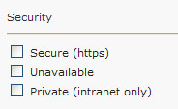
4.1 Page Properties
UNAVAILABLE - Make the page temporarily unavailable
Secure and Private will be removed from page properties in the next release of Hermes.
They must be left unchecked by the meantime.
Composed of the following settings: Secure, Unavailable and Private.
Security

Slide 14
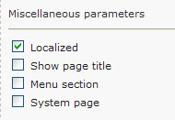
4.1 Page Properties
Show Page Title – To use Page Title as HTML page title
Localized, Menu Section and System Page will be removed in the next release of Hermes. It must be left checked by the meantime.
Composed of the following settings: Localized, Show page title, Menu section and System Page.
Miscellaneous parameters

Slide 15
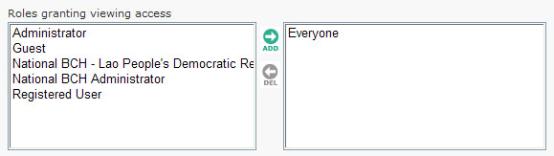
4.1 Page Properties
Set USER GROUPS that will be provided viewing access to the page.
Roles Granting
Viewing Access

Slide 16
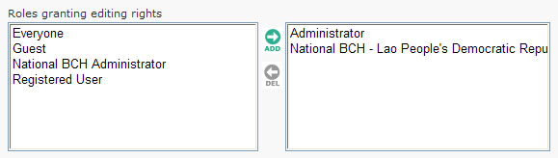
4.1 Page Properties
To identify USER GROUPS that will be provided with editing rights to the page.
Roles Granting
Editing Rights

Slide 17

4.1 Page Properties
Save Changes button – Save Page Properties.
Cancel Button – Cancel Settings
Save changes &
Cancel buttons

Slide 18

4.1 Page Properties
Delete Page button
Delete the current page

Slide 19
4.1.1 Language Buttons
Default language used shown below is English.
Please note that translation in other official UN languages could be facilitated in coordination with SCBD

Slide 20
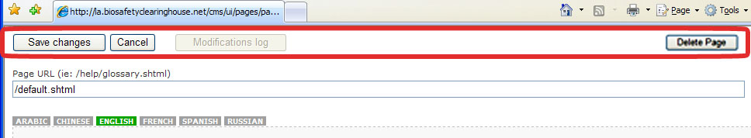
4.1.2 Save Changes, Cancel & Delete Page Buttons
Located at the topmost area of the page
These sets of buttons facilitate the following:
  saving/cancelling of whatever changes made to page properties
  deleting pages for whatever purposes (outdated, wrong position, etc)

Slide 21
4.1.3 How to ADD/DELETE User Groups from the Roles Granting Setup
The same procedure can be applied in identifying the User groups for the two Roles Granting set-up.
There are two boxes that contain group names for both the Roles granting viewing access and Roles granting editing rights.
The left box contains the set of usergroup names that can be selected.

Slide 22
4.1.3 How to ADD/DELETE User Groups from the Roles Granting Setup
The same procedure can be applied in identifying the User groups for the two Roles Granting set-up.
There are two boxes that contain group names for both the Roles granting viewing access and Roles granting editing rights.
The right box contains the names of the groups that were selected for the roles.

Slide 23
4.1.3 How to ADD/DELETE User Groups from the Roles Granting Setup
Between the boxes are two buttons: ADD (right arrow button) and DEL or delete (left arrow button)
ADD button
DELETE button

Slide 24
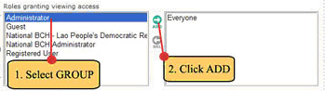
4.1.3 How to ADD/DELETE User Groups from the Roles Granting Setup
Steps in ADDING User Groups
Step 1. Identify the User group to be added by using left click. The group name identified will be highlighted in blue.
Step 2. Click the ADD button

Slide 25
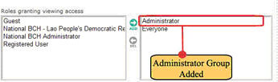
4.1.3 How to ADD/DELETE User Groups from the Roles Granting Setup
Steps in ADDING User Groups
After this, the selected user group will be included to the rightmost box. In this example, the Administrator group is added.

Slide 26
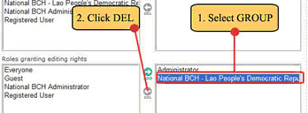
4.1.3 How to ADD/DELETE User Groups from the Roles Granting Setup
Steps in DELETING User Groups
Step 1. From the rightmost box, identify the User group to be deleted by using left click.
Step 2. Click the DEL button.

Slide 27
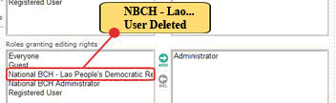
4.1.3 How to ADD/DELETE User Groups from the Roles Granting Setup
Steps in DELETING User Groups
After this, the selected user group will be included to the leftmost box. In this example, the NBCH – Lao People’s Democratic Republic Name was included on the leftmost box.

